Slide 1


Slide 2

SJSU Washington Square
Intelligent Branch Predictor Design
Presented by,
Ashok Aratikatla
Mounika Batthina
Mounika Boddapati
Susheel Kumar Bhargav
Vaishnavi Reddipalli
010805639
010693566
010828623
010826179
010826088

Slide 3
SJSU Washington Square
Introduction
Branches
Instructions which can alter the execution flow of the program.
Ex. beq, bne, jal, j etc.
How were branches handled traditionally ?
Stalling the subsequent instructions
Branch delay slot
Branch Prediction
Predicting the outcome of the branch beforehand , which allows the compiler to perform some useful work while waiting for branch result.
On misprediction the instructions in the pipeline should be flushed, take care that no stores/commits happen, exceptions to be handled appropriately.
Types
Static branch prediction(Prediction decided before the execution)
Dynamic branch prediction(Predictions may change during the execution)
Notes:
-->Why branch prediction ?? (Stalls Data Hazards)
What if the branches are not predicted !
What happens if wrongly predicted
How does the number of pipeline stages effect prediction(Branch penalty)
-->Type of branch predictors (Static and dynamic branch predictors)
Static and Dynamic predictions
Global, Private Histories

Slide 4
Hierarchy
Objective
Delay reduction
Accuracy improvement
Accomodate delay efficiency
Increase predictor capacity
Reduce interference
Bias free predictor
Misprediction reduction
Complementary
Prophet/Critic
Dynamic conditional execution
Branch profiling
Reuse of trace
Correlating on data values
Energy Conservation
On demand

Slide 5
Delay Reduction

Slide 6
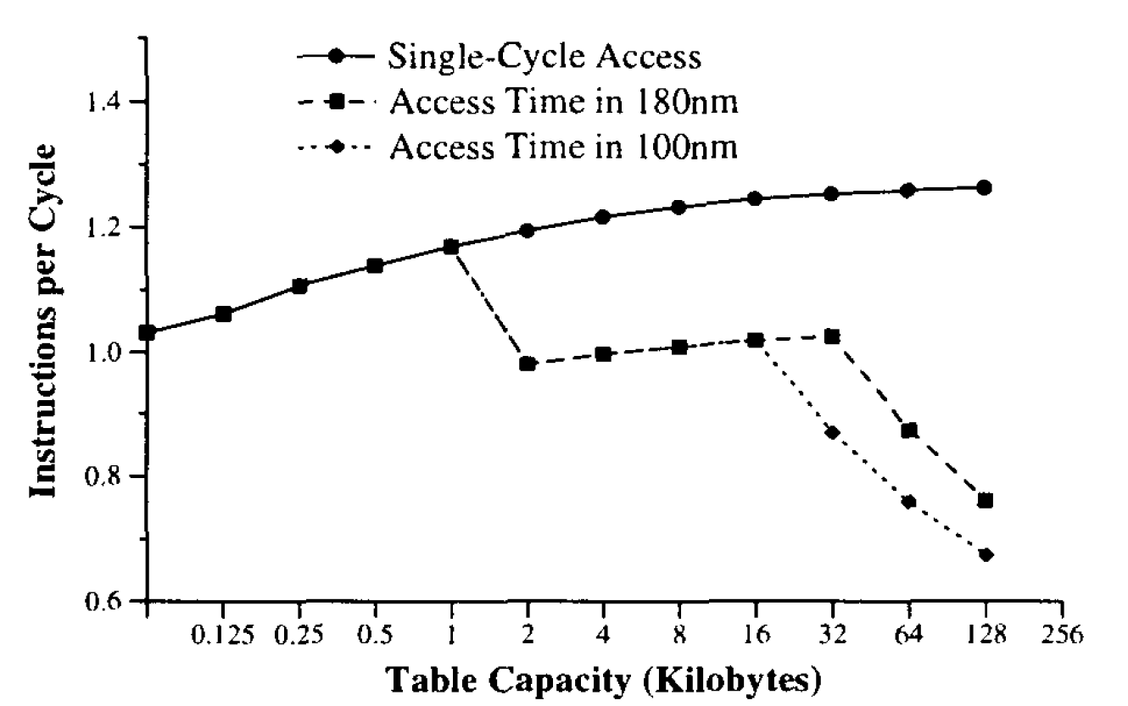
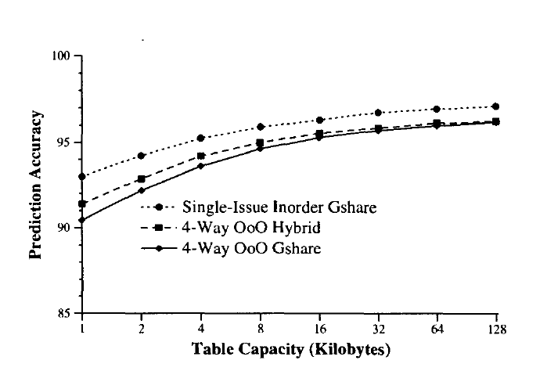
SJSU Washington Square
Impact Of Delay
Slower wires and faster clock rates will require multi-cycle to the prediction buffers
Hence it is important for us to consider delay during the design, other than the accuracy
and the area.
Using idealized single-cycle
access, IPC (and prediction accuracy) increases
with increasing pattern history table capacity.
As the capacity
increases, so does the prediction accuracy.

Slide 7
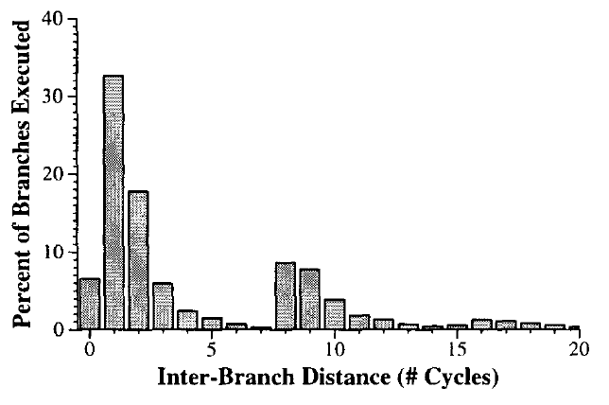
SJSU Washington Square
Over 60% of the prediction requests
occur at least one cycle after the previous
Request.
Approaches to overcome delay
Caching approach
Overriding approach
Cascading look ahead approach

Slide 8
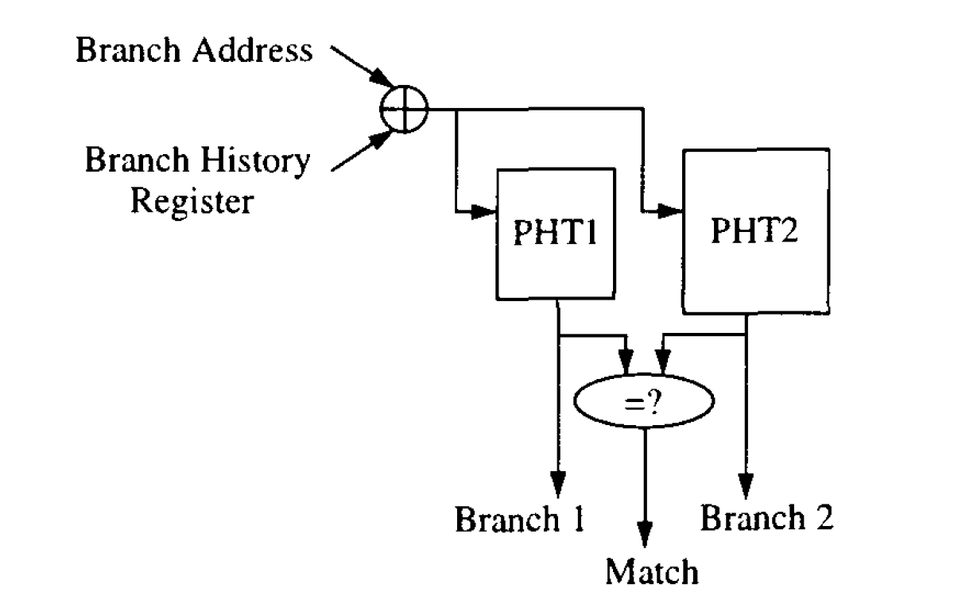
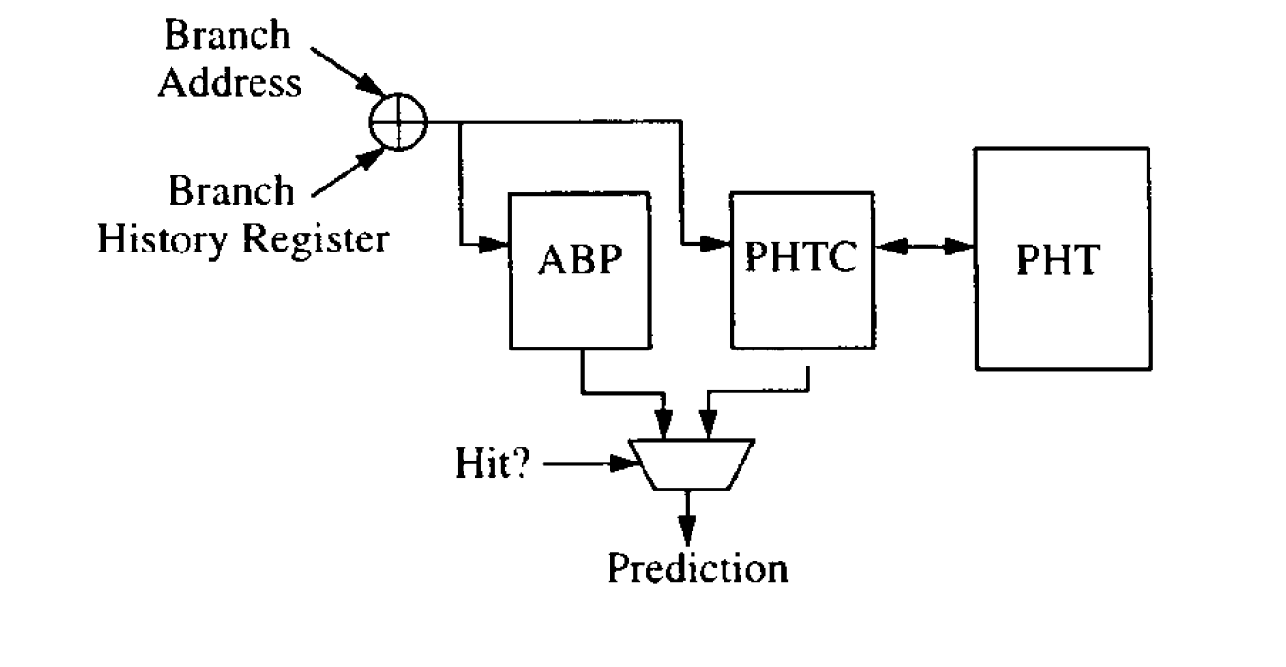
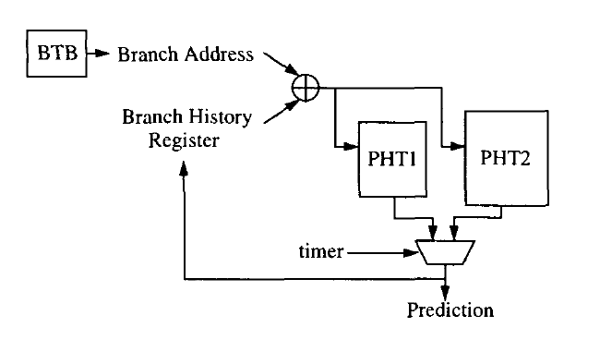
SJSU Washington Square
Caching approach
Overriding approach
Cascading look Ahead approach

Slide 9
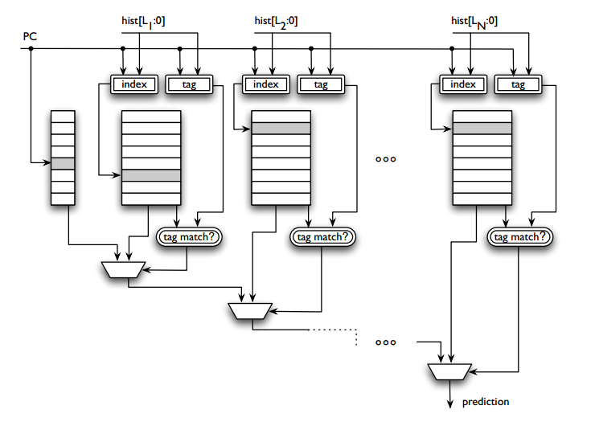
SJSU Washington Square
Predictor Virtualization
A methodology for increasing the effective capacity of predictors.
Transparently stores predictor metadata in a virtual predictor table using the memory hierarchy, while also recording the active predictor entries using on chip resources.
The TAGE Predictor with N Tagged Tables

Slide 10
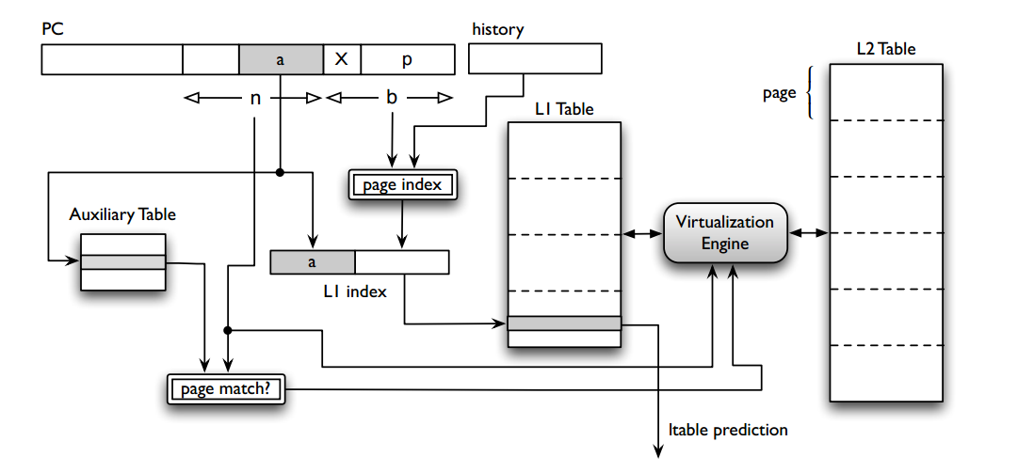
SJSU Washington Square
Paging scheme
One of the tagged predictor tables is augmented with a large second-level table.
Architecture
Virtualization Engine
Index hash function
Auxiliary Table
Paging Scheme Architecture

Slide 11
SJSU Washington Square
Paging implementation
Since the paging mechanism is applied to a single predictor table, It is ensured that increasing the perceived capacity of one table provides enough improvement to justify a paged design.
Determine the table that utilizes the increased capacity most efficiently to improve accuracy.
Model an idealized version of the predictor by replacing one of the predictor tables with a large table equal in size to the L2 table, representing the virtualized component

Slide 12
SJSU Washington Square
Experimental results
Paging scheme can improve accuracy by 8.7%, for a predictor whose size is determined by access delay constraints.
Can be used to achieve the same accuracy as a non-virtualized design while using 25% less dedicated storage.
A small overhead of just 704 bits of extra dedicated storage (off the critical path).

Slide 13
SJSU Washington Square
Energy Conservation

Slide 14
SJSU Washington Square
On-demand Dynamic Branch Prediction
Unnecessary branch prediction unit tables (BPU) for non-branch instructions
Combines static and dynamic branch prediction
Aims to perform dynamic prediction only when necessary allowing low energy and highly accurate branch prediction
Ahead type prediction to avoid lookups to branch prediction arrays
Principle
By using complier hits to identify instructions to be branch or can be statistically predicted and avoid Unnecessary lookups

Slide 15
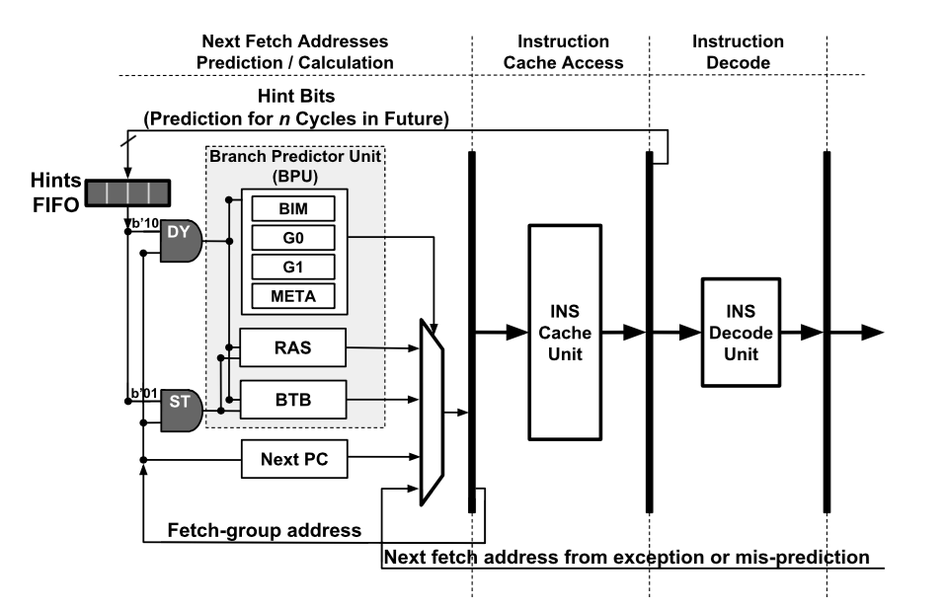
SJSU Washington Square
Architecture Implementation
Fetch Stage:
DY instructions look up all tables in BPU
ST instructions only look up branch target
buffer (BTB) and return address stack (RAS)
SN instructions access no BPU tables
Commit stage:
DY instructions update any table in BPU as needed
ST instructions update BTB and RAS when needed
SN instructions update no BPU tables.
Upon a mis-speculation or exception, the pipeline
Is flushed and the program resumes

Slide 16
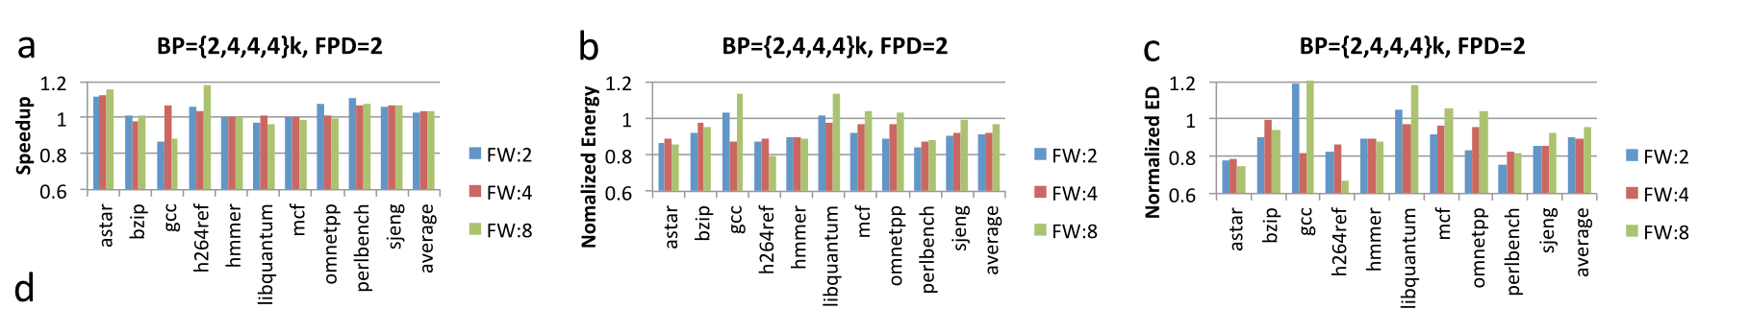

SJSU Washington Square
Results:
9 percent improvement in average energy-delay (ED) product,
7 percent core average energy saving,
3 percent speedup.

Slide 17
SJSU Washington Square
Accuracy Improvement

Slide 18
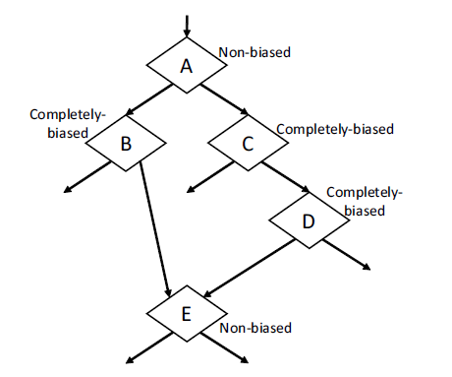
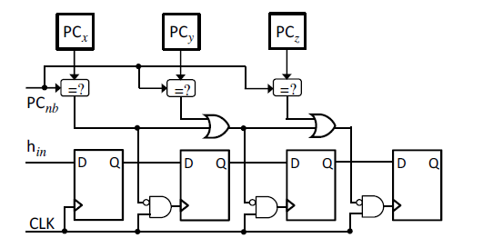
SJSU Washington Square
Bias Free Branch Predictor:
A bias ­free approach ensures that Tagged Geometric Length Predictor (TAGE) table can use less tables without affecting accuracy
The bias free predictor only picks up a branch if it is considered non­biased at the run time
Control Flow Graph
To track the most recently occurring branch, recently­ stack ­like (RS) structure is used.

Slide 19
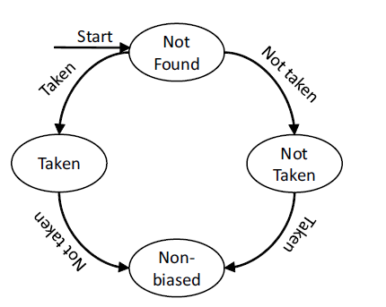
SJSU Washington Square
Implementation
The status of the branch is known from a branch status table (BST)
To avoid this we use a one dimensional weight table which is indexed for each non­biased branch added in RS.
If a branch is non­biased , it’s path history is placed and the previously detected non­biased branches have to re­learn their correlations with it which might affect accuracy
Biased Branch Detection Finite State Machine.

Slide 20
SJSU Washington Square
BF-TAGE Predictor
The BF­TAGE predictor divides the global history into segments which are overlapping and assigns RS (of size 1) to each of them
The size of RS is smaller than history segments they cover and hence long global histories (upto 2000 branches are covered)
When a branch B commits, it is entered in GHRunfiltered . Hash address and bias status are also stored along with it.
When this moves deeper in history, at length Lm it is considered as the next RS.

Slide 21
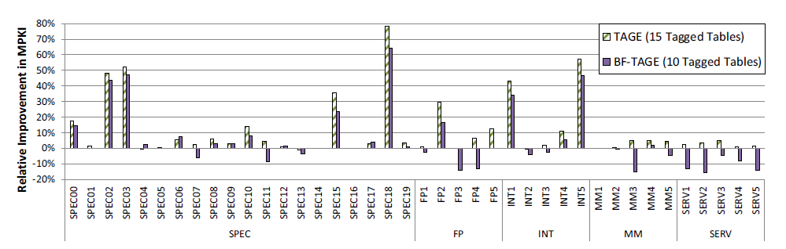
SJSU Washington Square
Performance :
For small to moderate number of tables, BF-TAGE consistently provides better accuracy.
A BF-TAGE with 7 tagged tables achieves a MPKI of 2.57 in comparison to 2.73 obtained using conventional TAGE.

Slide 22
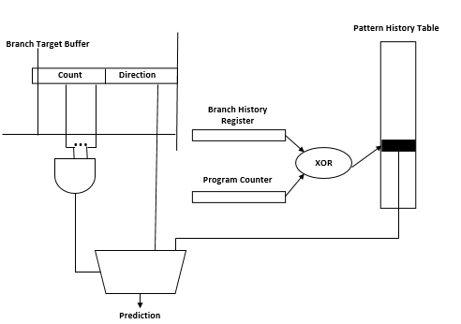
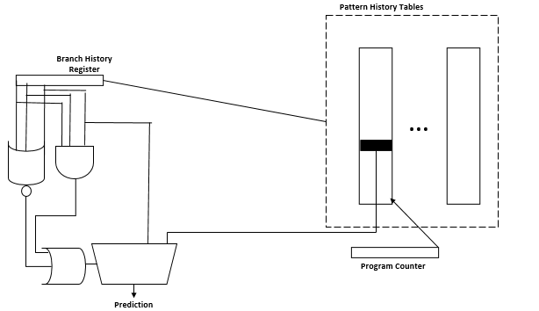
SJSU Washington Square
Improving Branch Prediction Accuracy by Reducing Pattern History Table Interference
Interference affects predictors accuracy
Using static prediction on the strongly biased branches and dynamic prediction on the remaining branches will result in lower conflicts in the pattern history table and thus more accurate predictions
Predictor Model :
Global History (g-share)
Per-Address History

Slide 23
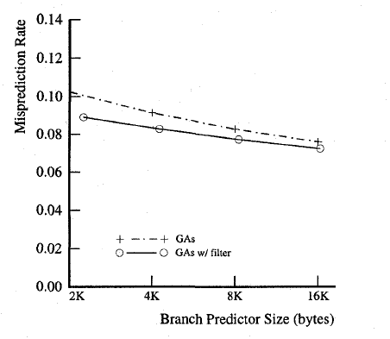
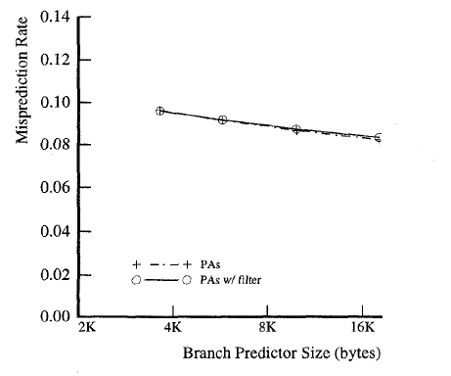
SJSU Washington Square
Predictor Performance :
When a conditional branch references an entry in PHT which was referenced before by another conditional branch, PHT interference takes place
g-share has more destructive interference
<< Performance of Per-address Adaptive (PA) scheme
Performance of Per-address Adaptive (PA) scheme >>
The performance of the filtering mechanism depends on the number of past history bits used for detecting regularly repeating patterns.

Slide 24
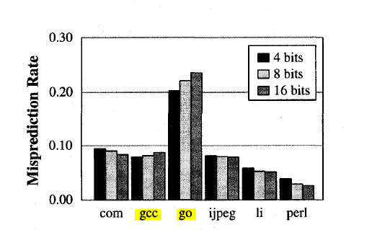
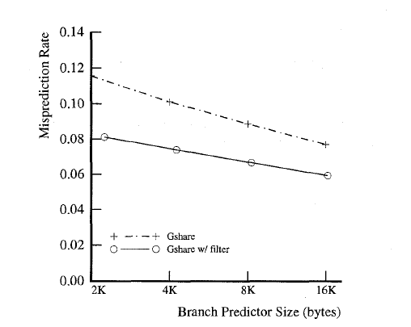
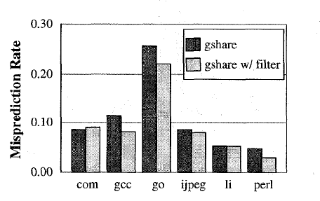
SJSU Washington Square
The predictor used in this experiment is a 2 KB g share with a 1K entry BTB
The last 8 occurrences of a branch for our filtering mechanism
The branch target buffer has 1K entries and is 4-way set associative
Performance vs. Branch History Length
Performance of g share on gcc benchmark
Performance of the 2 KB gshare

Slide 25
SJSU Washington Square
Misprediction Reduction

Slide 26
SJSU Washington Square
Improving Branch Prediction by correlating on data values
Key points:
Introduction of Branch Difference Predictor (BDP)
Use data values as additional information to improve the accuracy
Correct branch predictions avoid control dependences
Provide a smooth flow of instructions to be executed.
Branch Mispredictions halt fetching of until branch outcome is known.
Outcome:
Out of order execution window divided into serial segments
Worsens with window size
Improvements:
(1) Putting global path and history information together
(2) reducing table interference through more intelligent indexing schemes

Slide 27
SJSU Washington Square
Typical conditional branch predictor
Use control flow info as basic i/p
Steady improvements made only under this line
Approach:
Examined why some branches are difficult to predict
Reason for difficulty:
PCs and branch outcomes alone do not contain the right information, or the information is not in the right form.
Solution: data-value information can be used.
Methods:
speculative branch execution
Direct use of data values

Slide 28
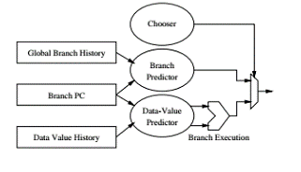
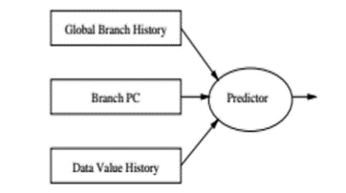
SJSU Washington Square
Speculative execution
A conventional data-value predictor is first used to predict the input values for a branch instruction and then the branch instruction is evaluated using the predicted values.
Feeding Data Values Directly
Data-value history information is fed directly into the branch predictor.
In effect, the predictor correlates on data values similar to the way conventional predictors correlate on global branch history.
First, it leads to a lower latency predictor than speculative branch execution.

Slide 29
SJSU Washington Square
Implementation
Because many branch instructions test two register values, we reduce the amount of data history by using the difference of the two branch source register operands instead of the operands themselves
The different values are stored in the Branch Difference Predictor
Since branch outcomes are based on subtracting the two inputs and looking at the sign and/or detecting a zero difference, these correlate very well.
Not all difference patterns need to be stored.
The conventional backing predictor predicts most cases without using difference values.
The small remaining subset of the patterns are predicted by a separate structure, a rare event predictor (REP), using both the data-value and global branch history.

Slide 30
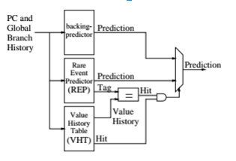
SJSU Washington Square
Branch Difference Predictor
Value history information is maintained per static branch, and is retrieved using the branch PC.
The BDP collects these branch difference values in the value history table (VHT)
While the VHT is being accessed, the REP is accessed in parallel with the PC and global branch history (GBH).

Slide 31
SJSU Washington Square
Results
Up to 33% reduction in the misprediction rate of five SPEC95 integer benchmarks
15% more than Bi-Mode predictors

Slide 32
SJSU Washington Square
Complementary Branch Predictors
Can be easily added to any branch predictor to improve the overall prediction accuracy.
Differs from conventional branch predictors in that it focuses only on mispredicted branches.
Predicting which future branch will be mispredicted next and when that will occur, and then it changes the predicted direction at the predicted time.

Slide 33
SJSU Washington Square
Implementation
BMP forms the index to Misprediction Branch Table
( PC of current mispredicted branch <XOR> global history bits) + (mispredicted history bits , branch misprediction distance)
The output of the MPBT is a prediction of the distance and address of the branch that is going to be mispredicted
The BMP forms the index again and accesses the MPBT to predict when the branch predictor will mispredict again

Slide 34
SJSU Washington Square
Implementation
The BMP decrements the predicted distance counter every time a branch instruction
is fetched till the predicted branch (until predicted distance=0)
When the predicted distance is zero then it compares.
[ ( predicted branch address) XOR ( PC of the current branch) ]
When they match, the BMP corrects the branch prediction (reverse its direction).

Slide 35
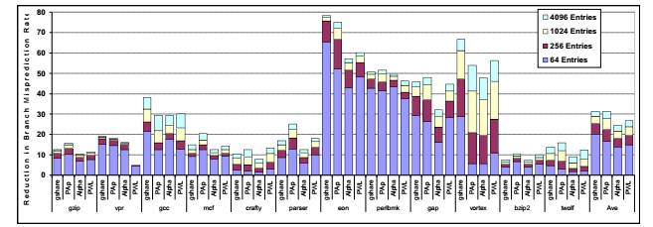
SJSU Washington Square
Percentage reduction in the branch misprediction rate after adding BMP for Spec2000int

Slide 36
Prophet And Critic
SJSU Washington Square
Multi-Hybrid predictors
Fusion Mechanism
Future bit usage
Overriding mechanism
Prophet
Initial prediction on a branch
Predicts based on history information
Starts prediction when branch is encountered
Critic
Final prediction on a branch
Predicts based on past behavior of prophet and future bits
Starts after prophet has finished few predictions after that branch

Slide 37
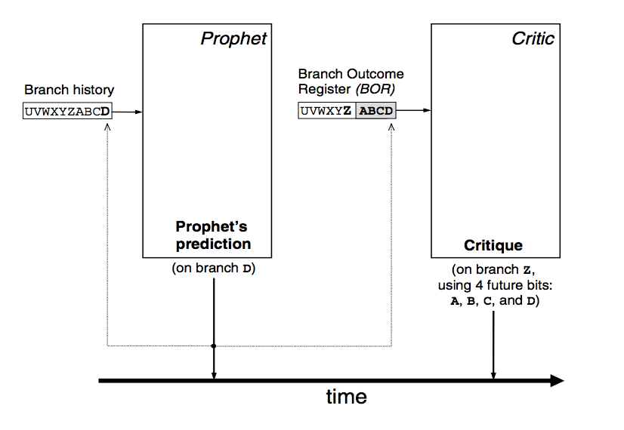
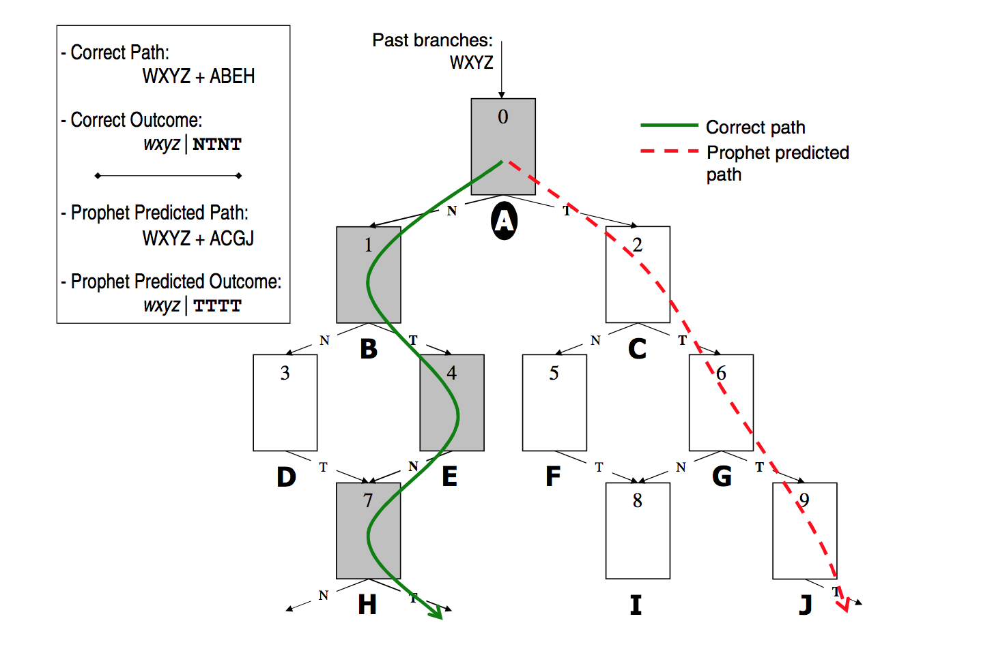
SJSU Washington Square
Working of Prophet and Critic

Slide 38
SJSU Washington Square
Functions
Updating the predictors
Branch history registers(BHR)
Branch Outcome Register(BOR)
Pattern tables
Recovering from a Mispredict
Check pointing
Filtering the critic
Dynamically identifying branches which are easy to predict

Slide 39
SJSU Washington Square
Implementation
Prophet gives initial prediction
Critic either agrees or disagrees after few stages
A decoupled front-end architecture is used
Fetch target queue decouples predictors from instruction cache
Branch target buffer(BTB) is used to recognize branches.

Slide 40
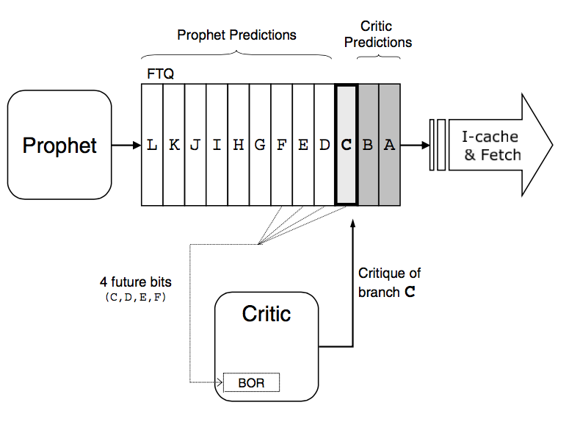
SJSU Washington Square
Cont.
When Critic disagrees prophet’s decision following actions are taken
Prophet’s prediction is overridden by critic’s prediction
Un-criticized predictions FTQ entries are flushed
critic redirects prophet in its predicted, correct path.

Slide 41
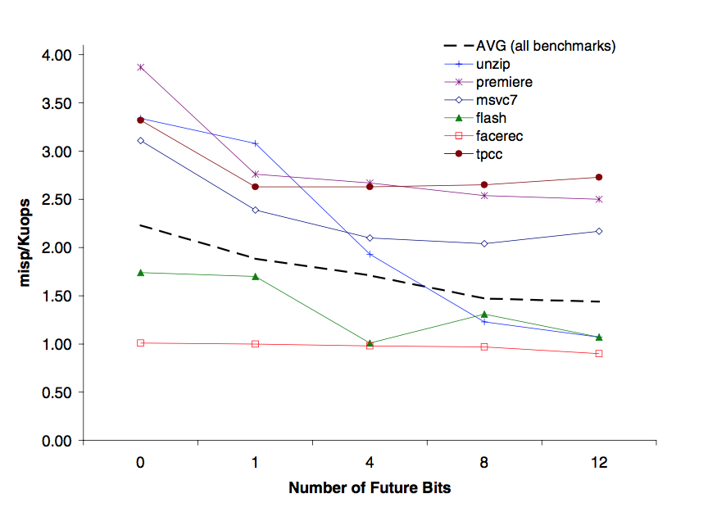
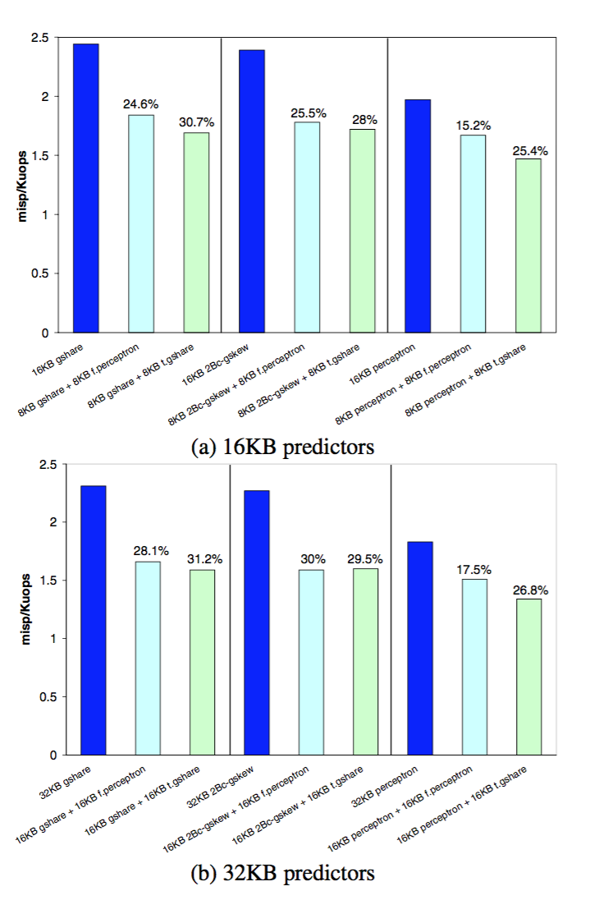
SJSU Washington Square

Slide 42
SJSU Washington Square
Dynamic Conditional Execution

Slide 43
SJSU Washington Square
Dynamic Conditional Execution
Why DCE?
Mispredictions are large in any super scalar pipeline.
Cost of branch Mispredictions is getting worse due to increase in number of pipeline stages.
Dynamic Conditional Execution
Fetches and executes all the paths produced by a branch.
Combines dynamic predication and multipath speculative execution.
Smaller number of predictions hence less branches are mispredicted.
Concerns
Executing all the paths of all branches is not efficient.
Increase in number of executed instructions.
Large overhead is introduced by fetching multiple paths and inserting replicas of the
same logical instruction.

Slide 44
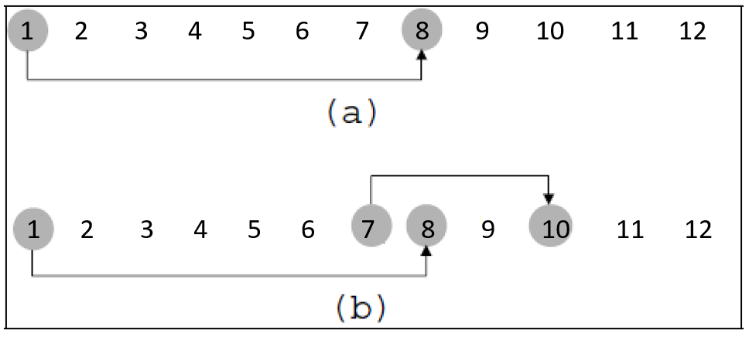
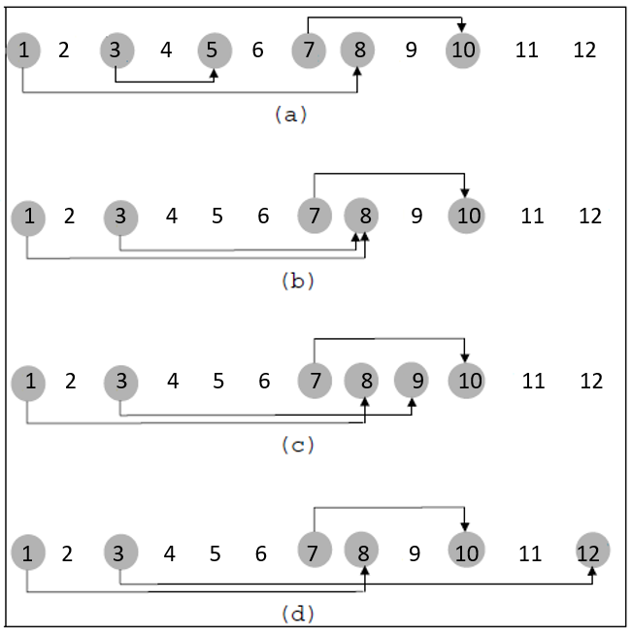
SJSU Washington Square
Hammock Classification
Figure – Simple hammock
Single sided (if-then)
Double sided (if-then-else)
Figure – Complex hammocks
Pure complex
Multiple join complex
Overlap complex
Multiple target complex

Slide 45
SJSU Washington Square
Result
The result of the simulation shows that by complex branch profiling, of all conditional branches 35% branches can be predicated and in these branches 32% of all branch mispredictions occur. This workaround on large percentage of Mispredictions can show a great improvement in overall performance.

Slide 46
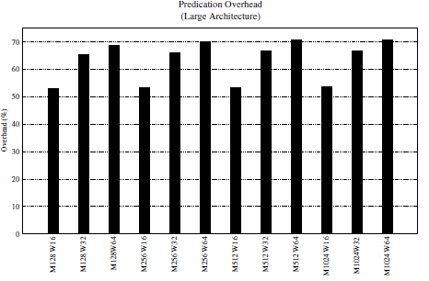
SJSU Washington Square
Overhead in DCE architecture
Predicating simple branches allows a reduction of 3.3 to 5.3% of mispredictions and for a set of complex branches almost doubles this reduction. But overall performance, did not increase due to the large overhead introduced by DCE.
DCE architecture introduces up to 70% more instructions in the pipeline, comparing to a regular superscalar.
Alternative?
Reuse the values produced by previous executions.

Slide 47
SJSU Washington Square
Reduction of overhead in DCE – Reusing Traces
Instruction reuse
When all source operands are ready and match with Reuse Buffer(RB).
Reused instructions need to be maintained in ROB – Problem!
Trace reuse
Reuses several instructions at once.
Trace – Sequence of contiguous instructions dynamically extracted from a given
program.
Larger the trace, the larger the number of resources saved.
Trace buffer(TB) – Instruction PC indexes this buffer and the values of the trace input/output context are retrieved from it whenever a match is verified.
Next PC of each trace is also stored in TB.
Instructions tagged but not producing output values are invalidated and removed from the pipeline.

Slide 48
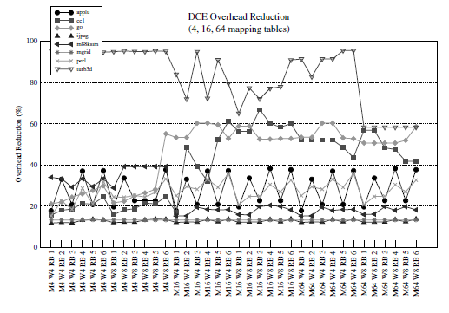
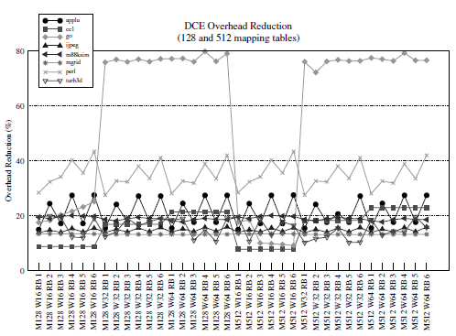
SJSU Washington Square
Simulation results
Overhead Reduction
Overhead – Difference between the number of dispatched instructions in DCE and in
a superscalar architecture.
By fetching multiple paths
Creation of replicas
Figure – Overhead reduction (Small and large architectures)
Wider architectures have more opportunities to reuse, as there are more paths in course.

Slide 49
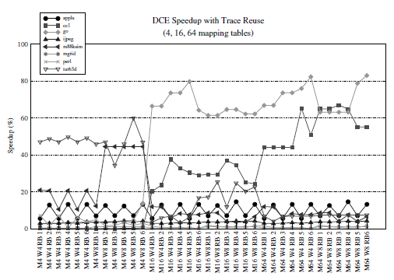
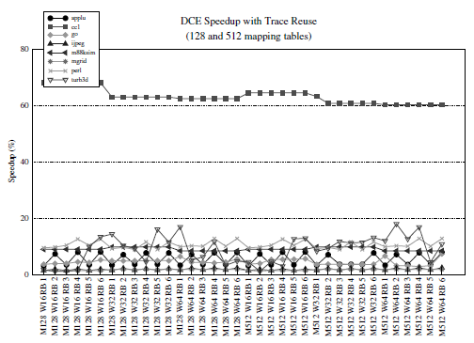
SJSU Washington Square
Simulation results
Speedup
The speedup is calculated using the IPC of each configuration, with and without
trace reuse.
Figure – Percentage of gain in speedup(small and large architectures)
Reuse of traces results in speedup from 8% to 12%

Slide 50
SJSU Washington Square
Comparison of Approaches
The above approaches can be split into three ways
i) Adding a Component to improve prediction (Branch Difference Predictor, Misprediction Predictor, Building a Cache)
ii)Modifying an existing component and managing resources to improve prediction (Bias free branch predictor, Reducing Interference, accommodating delay)
iii) Come up with a new predictor design (Prophet/Critic Hybrid Predictor)

Slide 51
SJSU Washington Square
Comparison of Approaches
Objectives | Approach | Pros | Cons
Delay Reduction | Accommodating delay | Capacity of the predictor varies with access time. | Tags needed to implement caching scheme requires more bits than the cache itself
 | Increasing predictor capacity | No increase in latency with increase in capacity Negligible overhead | Processor cycles are approximate to emulate delay of predictor table.
Energy Conservation | On demand | Can adapt to dynamic changes in branch behavior No need for static profiling Increase Speedup by 3% | More complex (requires additional hardware) Account for the energy and performance overhead of hints in the instruction cache.
Accuracy Improvement | Reducing Interference | Lower implementation cost 14% reduction of mispredictions for a 2 KB gshare predictor. | For the benchmarks other than gcc and gshare, Accuracy is given more importance than interference
 | Bias free predictor | BF-TAGE observes the expected shift in the branch’s distributions. It reduces noisy correlations. | Restricts the predictor from learning correlations with biased branches. Hardware overhead and energy consumption.

Slide 52
SJSU Washington Square
Comparison of Approaches
Objective | Approach | Pros | Cons
Accuracy Improvement | Complementary | Reduction of Energy consumption & Mispredictions. | As the BMP is not on the processor’s critical path It will be accessed only after a branch misprediction. Predictions done for future branches only.
 | Correlating on data values | Increase in Prediction accuracy. Larger history registers are not required. | The replacement policy for rare event predictor s to be managed carefully. Conventional replacement policies will not work.
 | Prophet/Critic | Increased performance Increased accuracy | Longer access latency More complex
 | DCE – Complex branch profiling | Workaround on large percentage of Mispredictions can be done. Great improvement in overall performance. | Resource contention leads to large overhead generation.
 | DCE – Trace reuse | Overhead reduction Speedups from 8% to 12%. Reduced ROB utilization | A new buffer is necessary to hold the input and output context of the traces

Slide 53
SJSU Washington Square
FUTURE RESEARCH
Rather than an all inclusive design approach, predictor parameters can be adjusted to suit the program being run.
Progress can be made by intelligent assimilation of the information beyond data values & PC into branch predictors for improving accuracy.
Reducing hardware budget requirements also need further research so that power consumption will be less.
Significant improvements with compiler optimizations and introduction of an out-of-order commit mechanism should be studied for predication improvement

Slide 54
Conclusion
SJSU Washington Square
In this paper we have examined a number of alternative branch predictor architectures and evaluated them in the context of future process technologies.
The ultimate goal is to design a best predictor which has maximum accuracy and minimal delay.
In the papers discussed, we have studied how a technique works and gave some insights as to why it is needed to work in a specific way.
Finally, comprehensive overview of various methods to attain a better performance is discussed.

Slide 55
SJSU Washington Square
Thank you

Slide 56


